Slide 1
The Muscular System:
Part D
10

Slide 2
Muscles Crossing Hip and Knee Joints
Most anterior muscles flex femur at hip, extend leg at knee (foreswing of walking)
Most posterior muscles extend thigh, flex leg (backswing of walking)
Medial muscles all adduct thigh
All three groups enclosed by fascia lata
PLAY
A&P Flix™: Muscles that act on the hip joint and femur:
An overview

Slide 3
Movements of the Thigh
Include flexion, extension, abduction, adduction, circumduction, and rotation
Thigh flexors pass in front of hip joint
  Iliopsoas (iliacus and psoas major) - prime mover of flexion
  Tensor fasciae latae
  Rectus femoris
  Assisted by medial adductors and sartorius
PLAY
A&P Flix™: Anterior muscles that cross the hip joint

Slide 4
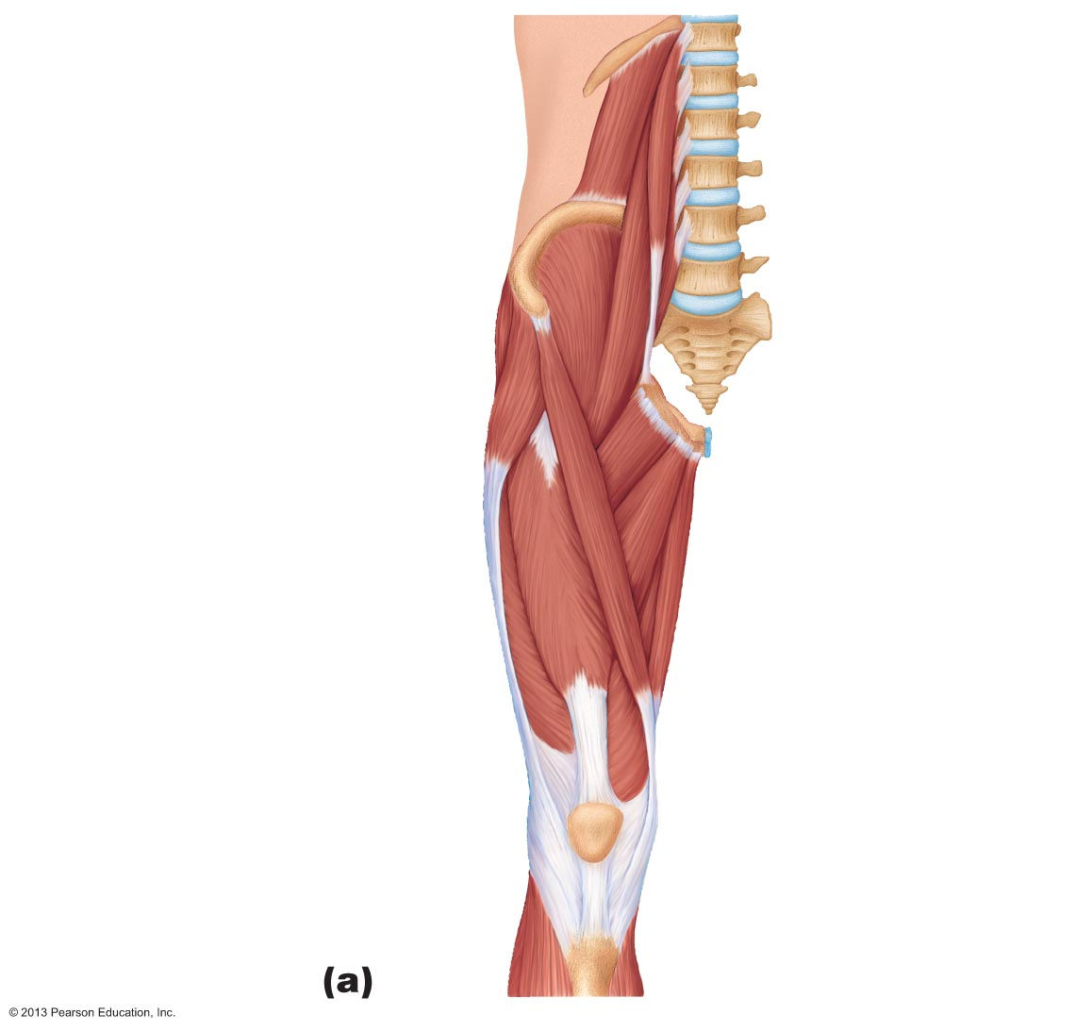
Figure 10.20a Anterior and medial muscles promoting movements of the thigh and leg.
12th thoracic
vertebra
12th rib
Quadratus lumborum
Psoas minor
Iliac crest
Iliopsoas
Psoas major
Iliacus
5th lumbar
vertebra
Anterior superior
iliac spine
Tensor fasciae latae
Pectineus
Sartorius
Adductor longus
Quadriceps femoris
• Rectus femoris
Gracilis
Adductor magnus
• Vastus lateralis
• Vastus medialis
Tendon of
quadriceps femoris
Patella
Patellar
ligament

Slide 5
Movements of the Thigh
PLAY
A&P Flix™: Iliopsoas
PLAY
A&P Flix™: Tensor fasciae latae
PLAY
A&P Flix™: Rectus femoris
PLAY
A&P Flix™: Sartorius

Slide 6
Movements of the Thigh
Thigh extensors
  Hamstring muscles - prime movers of extension
    Biceps femoris
    Semitendinosus
    Semimembranosus
    Gluteus maximus – assists hamstrings in forceful thigh extension

Slide 7
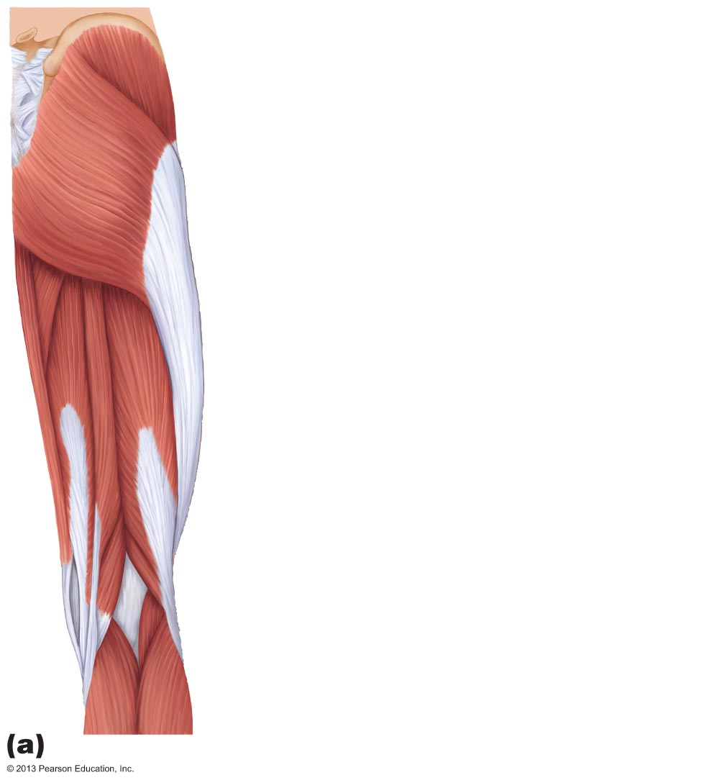
Figure 10.21a Posterior muscles of the right hip and thigh.
Gluteus medius
Gluteus
maximus
Adductor magnus
Gracilis
Iliotibial tract
Long head
Biceps
femoris
Short head
Hamstrings
Semitendinosus
Semimembranosus

Slide 8
Movements of the Thigh
PLAY
A&P Flix™: Biceps femoris
PLAY
A&P Flix™: Semitendinosus
PLAY
A&P Flix™: Semimembranosus

Slide 9
Movements of the Thigh
Adductors (also medially rotate thigh)
  Adductor magnus
  Adductor longus
  Adductor brevis
  Pectineus
  Gracilis
PLAY
A&P Flix™: Medial muscles that cross the hip joint

Slide 10
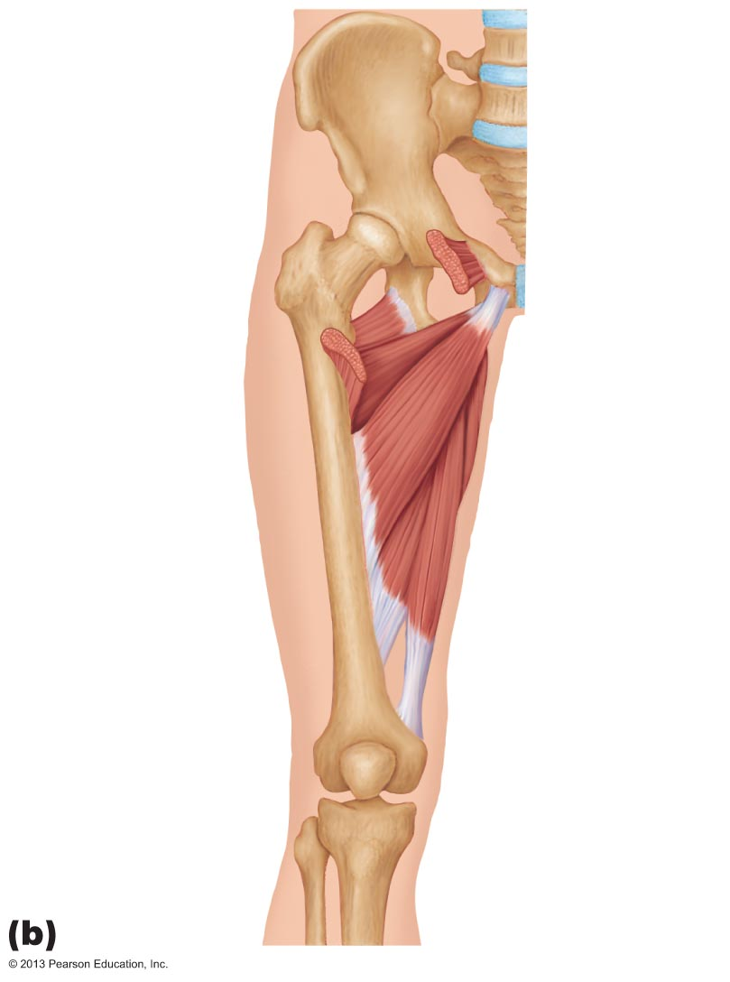
Figure 10.20b Anterior and medial muscles promoting movements of the thigh and leg.
Pectineus
(cut)
O
O
Adductor
brevis
Adductor
magnus
I
Adductor
longus
I
I
Femur
O = origin
Ι = insertion
PLAY
A&P Flix™: Pectineus

Slide 11
Movements of the Thigh
Abductors
  Gluteus maximus (also laterally rotates thigh)
  Gluteus medius (also medially rotates thigh)
  Gluteus minimus (also medially rotates thigh)
  Piriformis (also laterally rotates thigh)
  Obturator externus (also laterally rotates thigh)
  Obturator internus (also laterally rotates thigh)
  Gemellus (also laterally rotates thigh)
PLAY
A&P Flix™: Posterior muscles that cross the hip joint

Slide 12
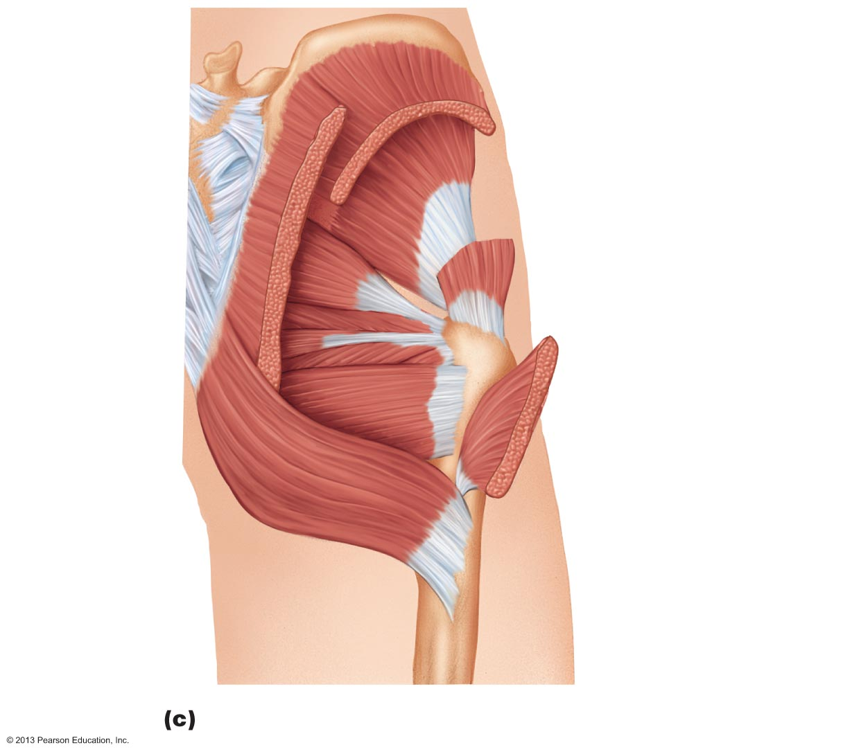
Figure 10.21c Posterior muscles of the right hip and thigh.
Gluteus medius
(cut)
Gluteus minimus
Superior
gemellus
Piriformis
Obturator
internus
Obturator
externus
Inferior
gemellus
Quadratus
femoris
Gluteus maximus
(cut)

Slide 13
Movements of the Thigh
PLAY
A&P Flix™: Gluteus maximus(c)
PLAY
A&P Flix™: Gluteus medius

Slide 14
Summary of Movement at the Hip Joint
PLAY
A&P Flix™: Movement at the hip joint

Slide 15
Muscles of the Thigh that Move the Knee Joint
Quadriceps femoris—sole extensor of knee
Hamstring muscles—flex knee; antagonists to quadriceps femoris
PLAY
A&P Flix™: Muscles that cross the knee joint: An overview.

Slide 16
Figure 10.20a Anterior and medial muscles promoting movements of the thigh and leg.
12th thoracic
vertebra
12th rib
Quadratus lumborum
Psoas minor
Iliac crest
Iliopsoas
Psoas major
Iliacus
5th lumbar
vertebra
Anterior superior
iliac spine
Tensor fasciae latae
Pectineus
Sartorius
Adductor longus
Quadriceps femoris
• Rectus femoris
Gracilis
Adductor magnus
• Vastus lateralis
• Vastus medialis
Tendon of
quadriceps femoris
Patella
PLAY
A&P Flix™: Movement at the hip joint
Patellar
ligament

Slide 17
Muscles of the Thigh that Move the Knee Joint
PLAY
A&P Flix™: Anterior extensors that act on the knee
PLAY
A&P Flix™: Rectus femoris
PLAY
A&P Flix™: Vastus lateralis
PLAY
A&P Flix™: Vastus medialis
PLAY
A&P Flix™: Vastus intermedius

Slide 18
Figure 10.21a Posterior muscles of the right hip and thigh.
Gluteus medius
Gluteus
maximus
Adductor magnus
Gracilis
Iliotibial tract
Long head
Biceps
femoris
Short head
Hamstrings
Semitendinosus
Semimembranosus
PLAY
A&P Flix™: Movement at the hip joint

Slide 19
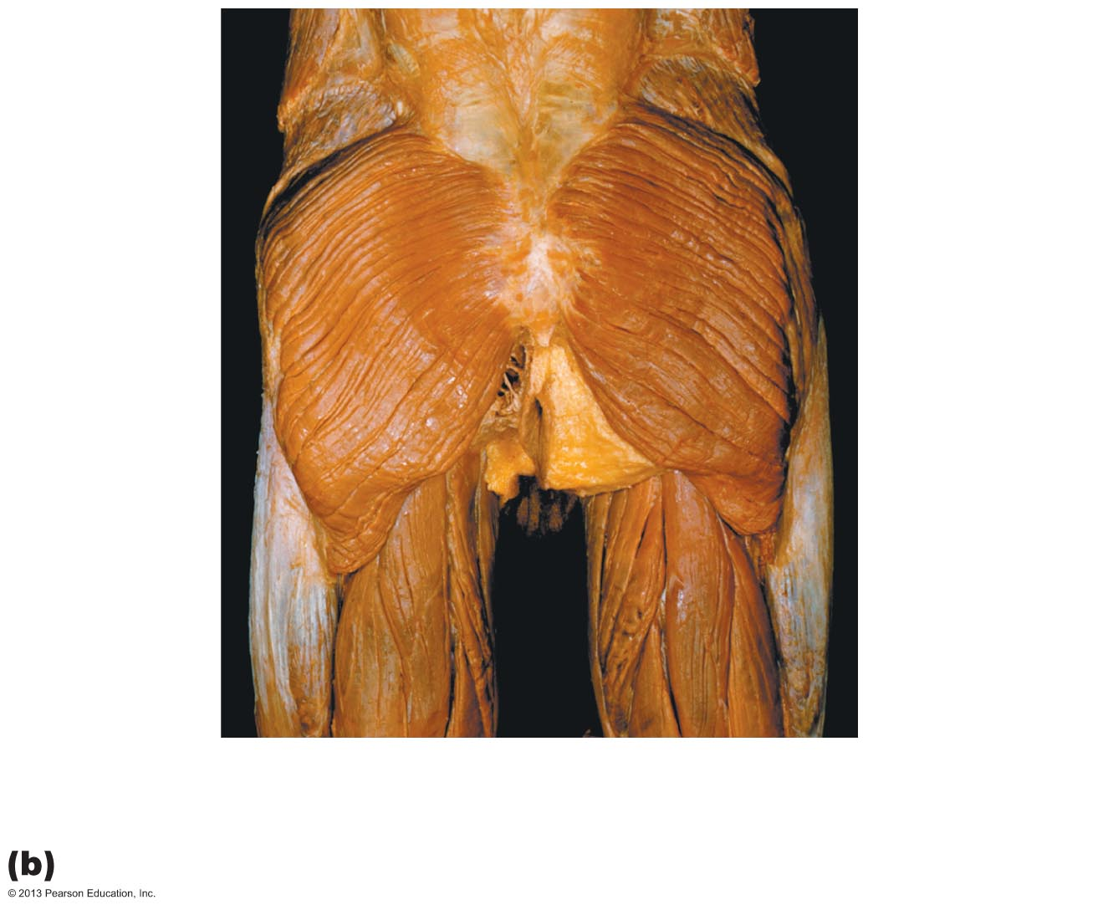
Figure 10.21b Posterior muscles of the right hip and thigh.
External
oblique
Lumbar
fascia
Iliac
crest
Gluteus
medius
Median
sacral
crest
(of sacrum)
Adductor
magnus
Gluteus
maximus
Gracilis
Iliotibial
tract
Biceps
femoris
Semitendinosus
Semimembranosus

Slide 20
Muscles of the Thigh that Move the Knee Joint
PLAY
A&P Flix™: Posterior flexors that act on the knee
PLAY
A&P Flix™: Biceps femoris
PLAY
A&P Flix™: Semitendinosus
PLAY
A&P Flix™: Semimembranosus

Slide 21
Summary of Movement at the Knee Joint
PLAY
A&P Flix™: Movement at the knee joint

Slide 22
Fascia of the Leg
Deep fascia of leg continuous with fascia lata
Segregates leg into three compartments - anterior, lateral, and posterior
Fascia thickens distally; forms flexor, extensor, and fibular retinaculae
PLAY
A&P Flix™: Muscles that act on the ankle and foot:
An overview

Slide 23
Muscles of the Leg: Movements
Various leg muscles produce following movements
  Ankle—dorsiflexion and plantar flexion
  Intertarsal joints—inversion and eversion of the foot
  Toes—flexion and extension
PLAY
A&P Flix™: Movements of the ankle and foot (a)

Slide 24
Muscles of the Anterior Compartment of the Leg
Primary toe extensors and ankle dorsiflexors
  Tibialis anterior
  Extensor digitorum longus
  Extensor hallucis longus
  Fibularis tertius (not always present)
PLAY
A&P Flix™: Anterior muscles that act on the ankle and foot

Slide 25
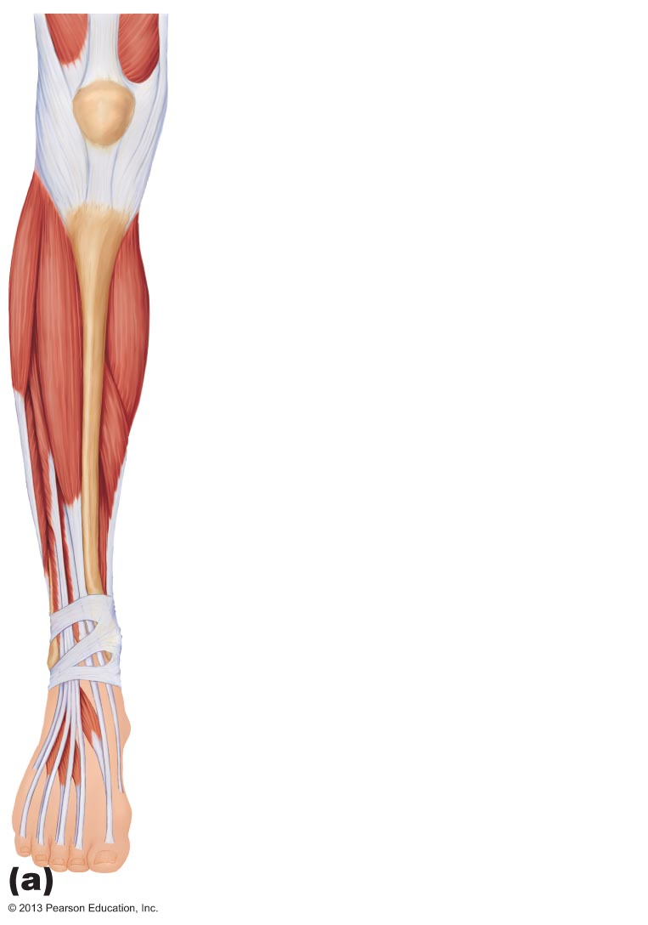
Figure 10.22a Muscles of the anterior compartment of the right leg.
Fibularis longus
Tibia
Gastrocnemius
Tibialis anterior
Extensor digitorum longus
Soleus
Extensor hallucis longus
Fibularis tertius
Superior and inferior
extensor retinacula
Extensor hallucis brevis
Extensor digitorum
brevis

Slide 26
Muscles of the Anterior Compartment of the Leg
PLAY
A&P Flix™: Tibialis anterior
PLAY
A&P Flix™: Extensor digitorum longus
PLAY
A&P Flix™: Extensor hallucis longus

Slide 27
Muscles of the Lateral Compartment of the Leg
Plantar flexion and eversion of the foot; stabilize lateral ankle and lateral longitudinal arch of foot
Fibularis longus
Fibularis brevis
PLAY
A&P Flix™: Lateral muscles that act on the ankle and foot

Slide 28
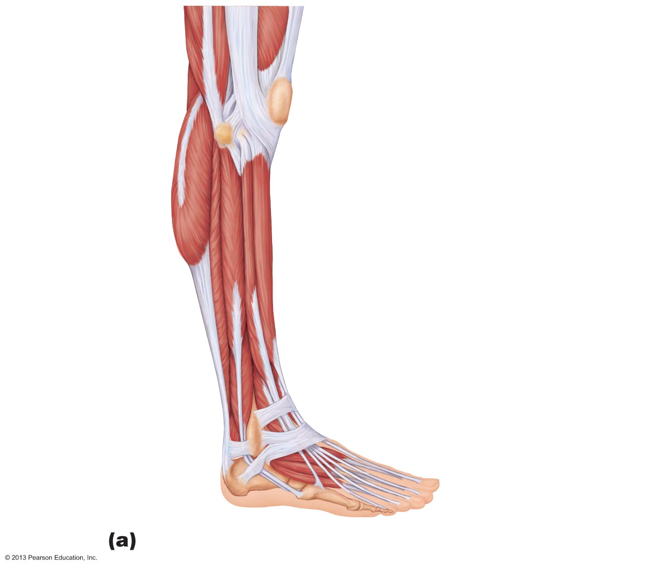
Figure 10.23a Muscles of the lateral compartment of the right leg.
Patella
Head of fibula
Gastrocnemius
Soleus
Fibularis longus
Extensor digitorum longus
Tibialis anterior
Fibularis brevis
Extensor hallucis longus
Fibularis tertius
Flexor hallucis
longus
Superior and inferior
extensor retinacula
Fibular retinaculum
Extensor hallucis
brevis
Lateral malleolus
Extensor digitorum
brevis
Metatarsal V

Slide 29
Muscles of the Lateral Compartment of the Leg
PLAY
A&P Flix™: Fibularis longus

Slide 30
Muscles of the Posterior Compartment of the Leg
Plantar flex ankle
  Gastrocnemius
  Soleus
  Plantaris
  Popliteus
  Flexor digitorum longus
  Flexor hallucis longus
  Tibialis posterior

Slide 31
Muscles of the Posterior Compartment of the Leg
PLAY
A&P Flix™: Superficial muscles that act on the ankle
and foot
PLAY
A&P Flix™: Deep posterior muscles that act on the ankle
and foot

Slide 32
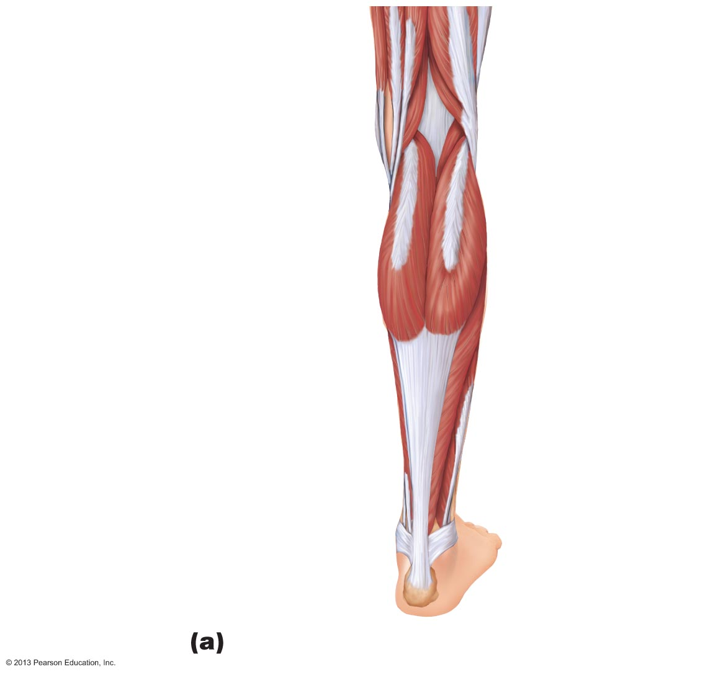
Figure 10.24a Muscles of the posterior compartment of the right leg.
Plantaris
Gastrocnemius
Medial head
Lateral head
Tendon of
gastrocnemius
Calcaneal
tendon
Medial
malleolus
Lateral malleolus
Calcaneus
Superficial view of the posterior leg.

Slide 33
Muscles of the Posterior Compartment of the Leg
PLAY
A&P Flix™: Gastrocnemius
PLAY
A&P Flix™: Soleus

Slide 34
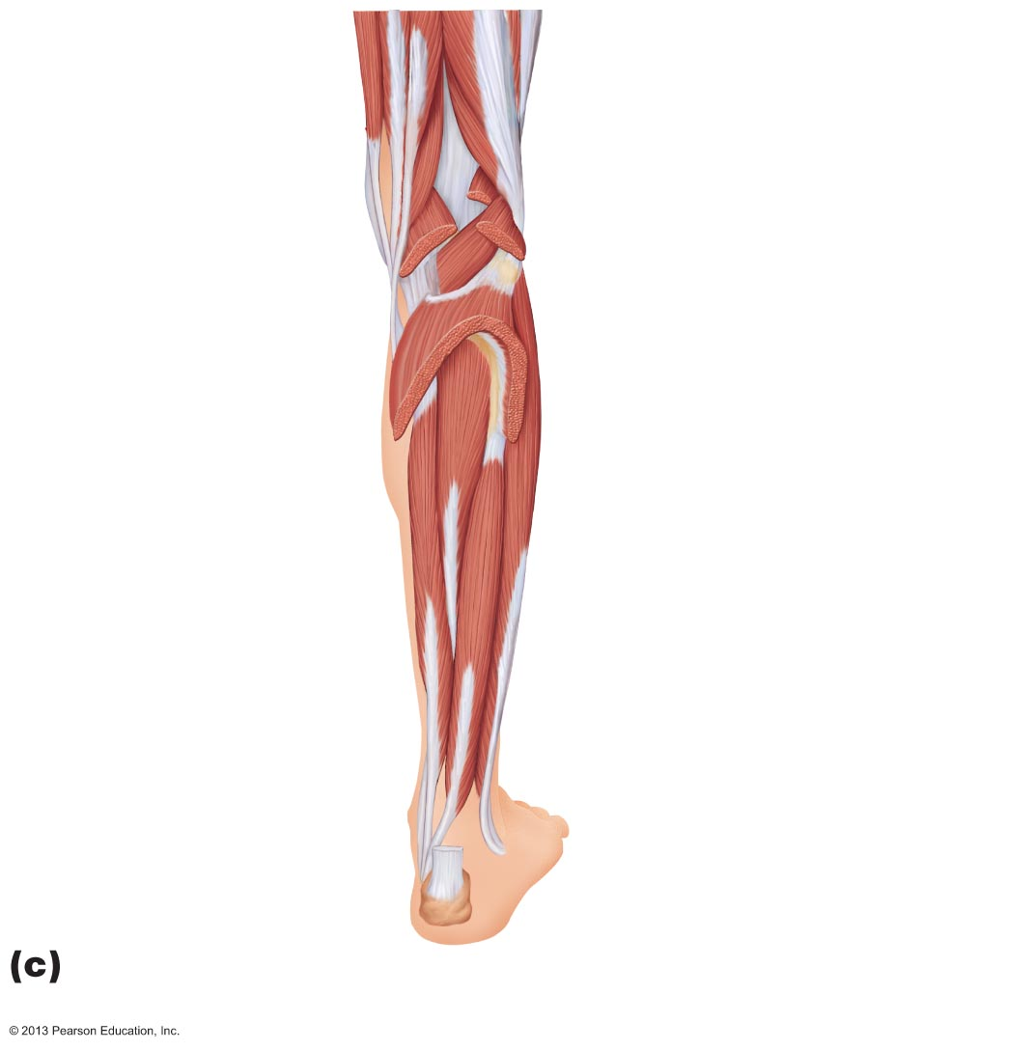
Figure 10.24c Muscles of the posterior compartment of the right leg.
Plantaris (cut)
Gastrocnemius
lateral head (cut)
Gastrocnemius
medial head
(cut)
Popliteus
Soleus (cut)
Tibialis posterior
Fibula
Fibularis
longus
Flexor digitorum
longus
Flexor hallucis
longus
Tendon of
tibialis posterior
Fibularis brevis
Medial
malleolus
Calcaneal
tendon (cut)
Calcaneus
The triceps surae has been removed to show the
deep muscles of the posterior compartment.

Slide 35
Muscles of the Posterior Compartment of the Leg
PLAY
A&P Flix™: Tibialis posterior
PLAY
A&P Flix™: Flexor digitorum longus
PLAY
A&P Flix™: Flexor hallucis longus

Slide 36
Major Actions of Muscles Acting on the Thigh, Leg, and Foot
Summary of major actions of muscles acting on thigh, leg, and foot next five slides

Slide 37
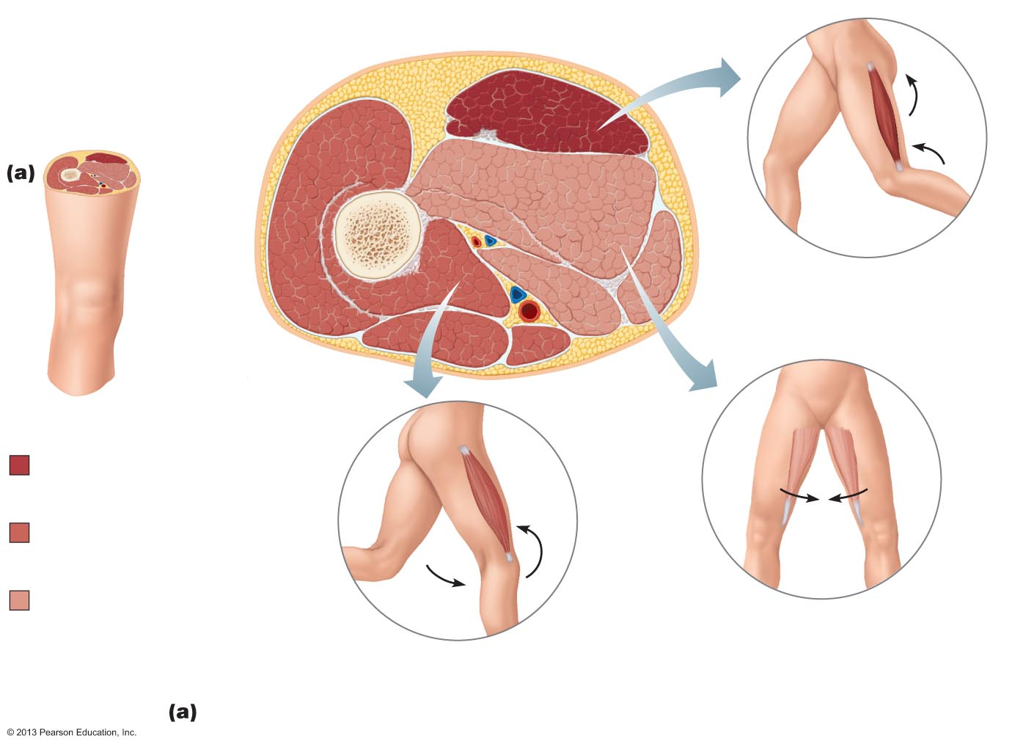
Figure 10.26a Summary: Actions of muscles of the thigh and leg.
Adductors
Hamstrings
Vastus
lateralis
Femur
Vastus
intermedius
Posterior compartment of
thigh (flexes leg and extends
thigh); innervated by tibial nerve
(portion of sciatic nerve)
Rectus femoris
Vastus medialis
Key:
Posterior
compartment
muscles
Anterior
compartment
muscles
Medial
compartment
muscles of thigh
and lateral
compartment
muscles of leg
Medial compartment of thigh
(adducts thigh); innervated by
obturator nerve
Anterior compartment of thigh
(extends leg); innervated by femoral
nerve
Muscles of the thigh

Slide 38
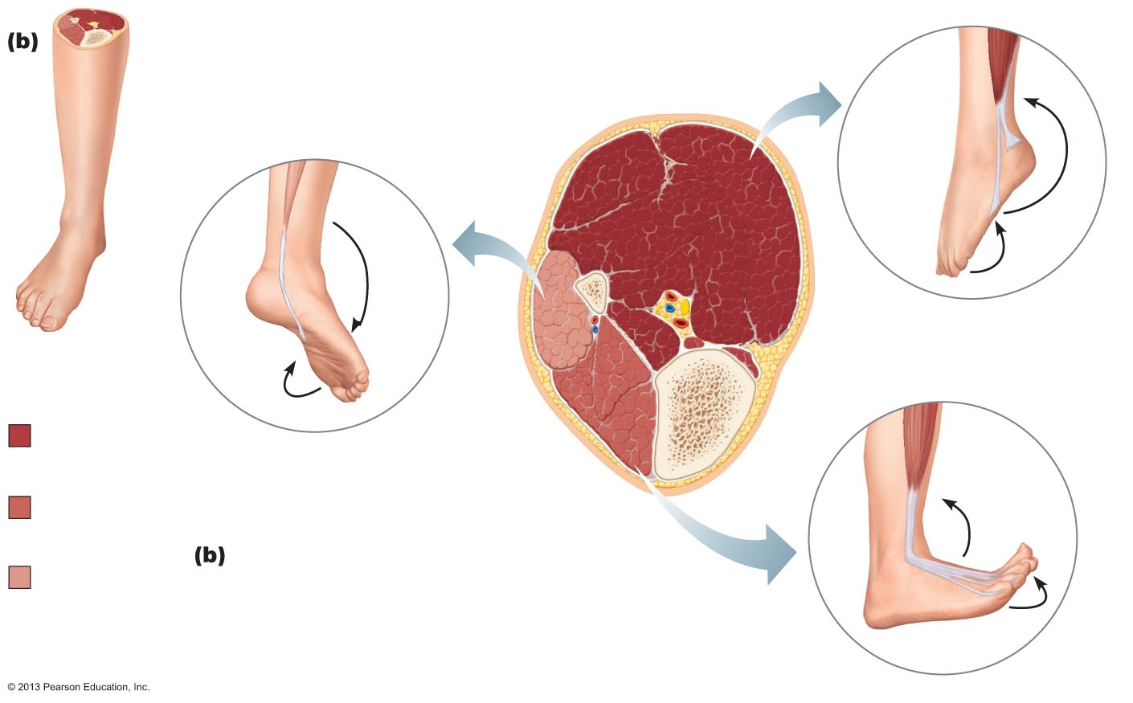
Figure 10.26b Summary: Actions of muscles of the thigh and leg.
Triceps surae
Fibula
Fibularis
muscles
Posterior compartment
of leg
(plantar flexes foot, flexes
toes);
innervated by tibial nerve
Key:
Tibialis
anterior
Posterior
compartment
muscles
Lateral compartment of leg
(plantar flexes and everts foot);
innervated by superficial
fibular nerve
Tibia
Anterior
compartment
muscles
Muscles of the leg
Medial
compartment
muscles of thigh
and lateral
compartment
muscles of leg
Anterior compartment of leg
(dorsiflexes foot, extends toes);
innervated by deep fibular nerve

Slide 39
Major Actions of Muscles Acting on the Ankle and Foot
PLAY
A&P Flix™: Actions of the muscles of the anterior
compartment of the leg
PLAY
A&P Flix™: Actions of the muscles of the lateral
compartment of the leg
PLAY
A&P Flix™: Actions of the muscles of the posterior
compartment of the leg

Slide 40
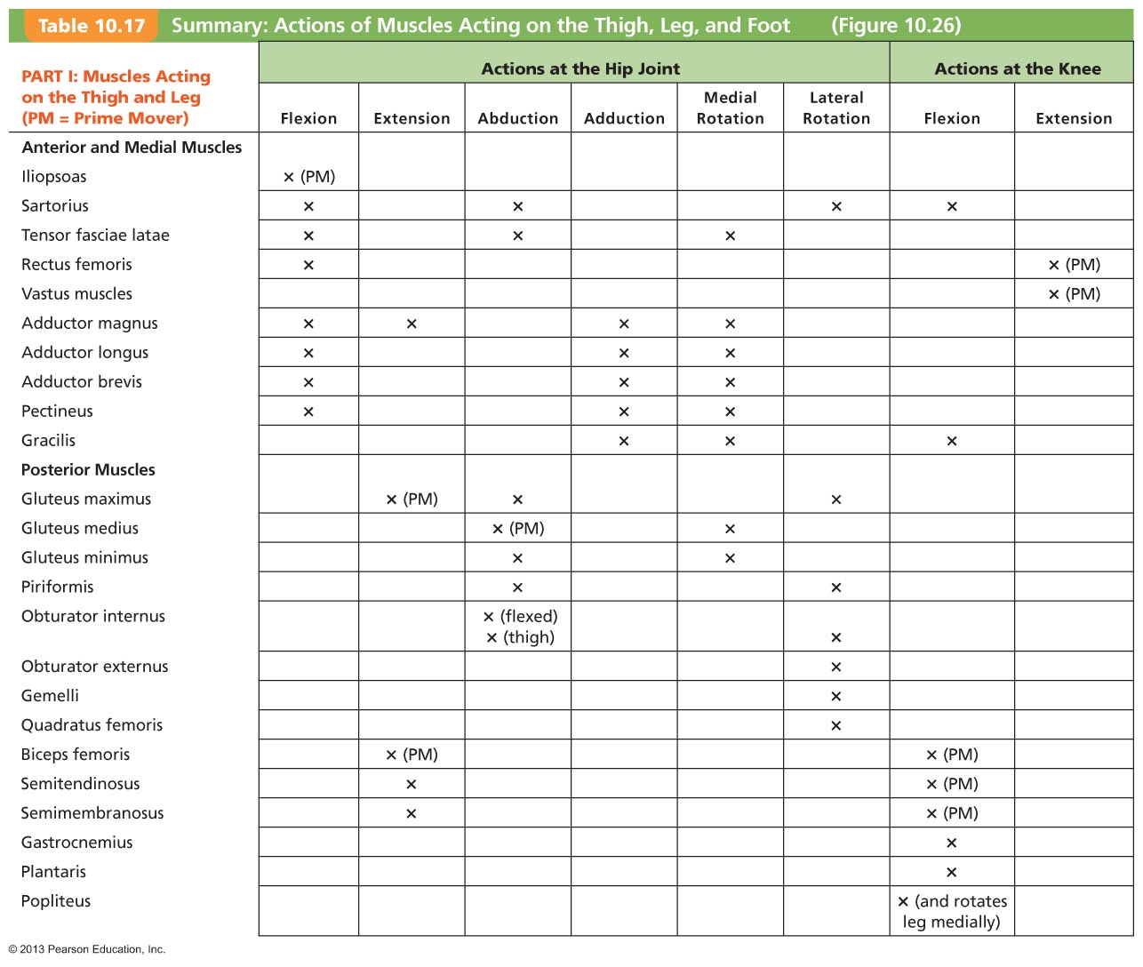
Table 10.17 Summary: Actions of Muscles Acting on the Thigh, Leg, and Foot. (1 of 2)

Slide 41
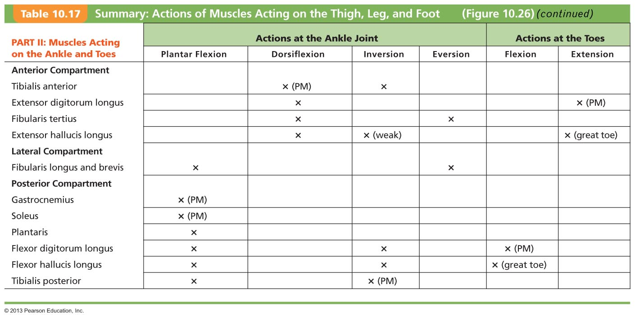
Table 10.17 Summary: Actions of Muscles Acting on the Thigh, Leg, and Foot. (2 of 2)

Slide 42
Intrinsic Muscles of the Foot
Help flex, extend, abduct, and adduct toes
Support arches of foot; some leg tendons assist
Extensor digitorum brevis—dorsal foot muscle; helps extend toes

Slide 43
Figure 10.22a Muscles of the anterior compartment of the right leg.
Fibularis longus
Tibia
Gastrocnemius
Tibialis anterior
Extensor digitorum longus
Soleus
Extensor hallucis longus
Fibularis tertius
Superior and inferior
extensor retinacula
Extensor hallucis brevis
Extensor digitorum
brevis

Slide 44
Plantar Muscles
Four layers of plantar muscles
  Superficial layer
    Flexor digitorum brevis
    Abductor hallucis
    Abductor digiti minimi
  Second layer
    Flexor accessorius
    Lumbricals

Slide 45
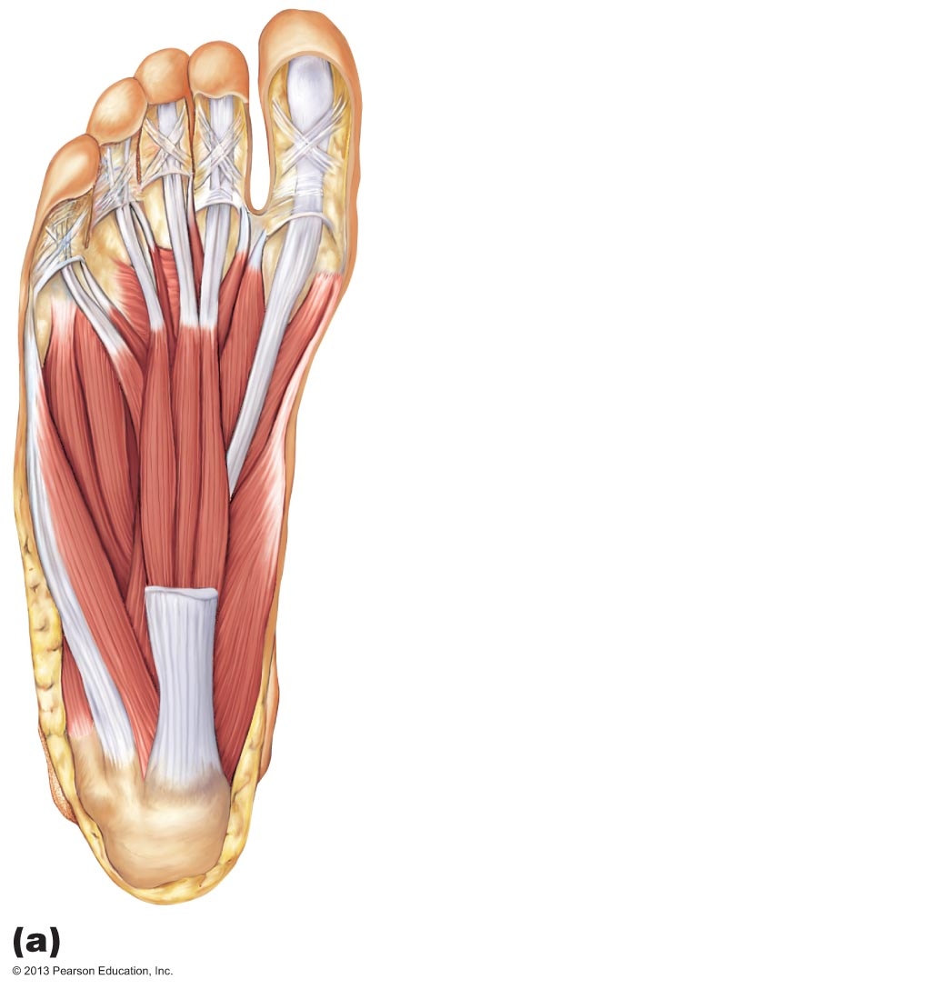
Figure 10.25a Muscles of the right foot, plantar aspect.
Tendon of flexor hallucis longus
Lumbricals
Flexor hallucis brevis
Flexor digiti minimi brevis
Abductor hallucis
Flexor digitorum brevis
Flexor accessorius
Abductor digiti minimi
Calcaneal tuberosity
First layer (plantar aspect)

Slide 46
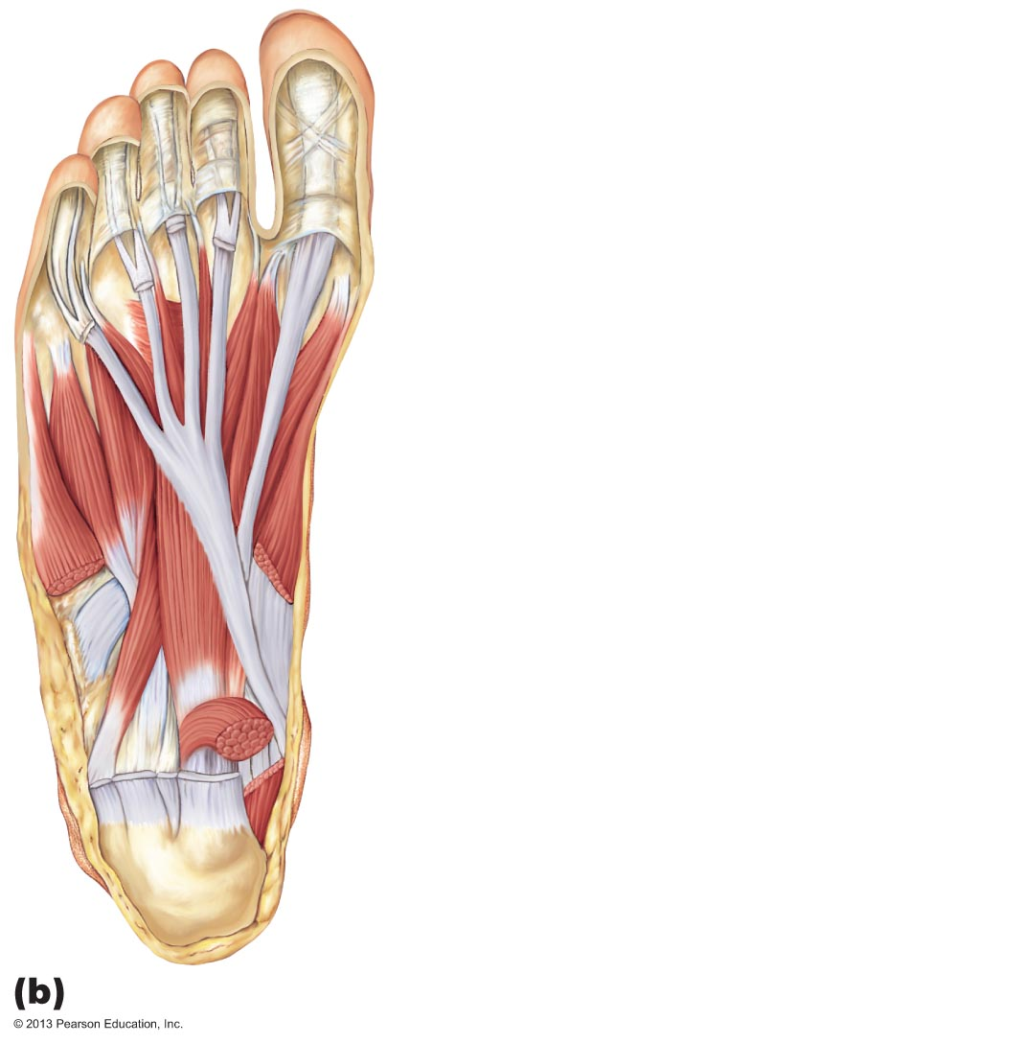
Figure 10.25b Muscles of the right foot, plantar aspect.
Lumbricals
Flexor hallucis brevis
Flexor hallucis longus tendon
Flexor digitorum longus (tendon)
Flexor digiti minimi brevis
Abductor digiti minimi
Flexor accessorius
Fibularis longus (tendon)
Flexor digitorum longus (tendon)
Flexor hallucis longus (tendon)
Second layer (plantar aspect)

Slide 47
Plantar Muscles
Third layer
  Flexor hallucis brevis
  Adductor hallucis
  Flexor digiti minimi brevis
Deepest layer
  Plantar and dorsal interossei

Slide 48
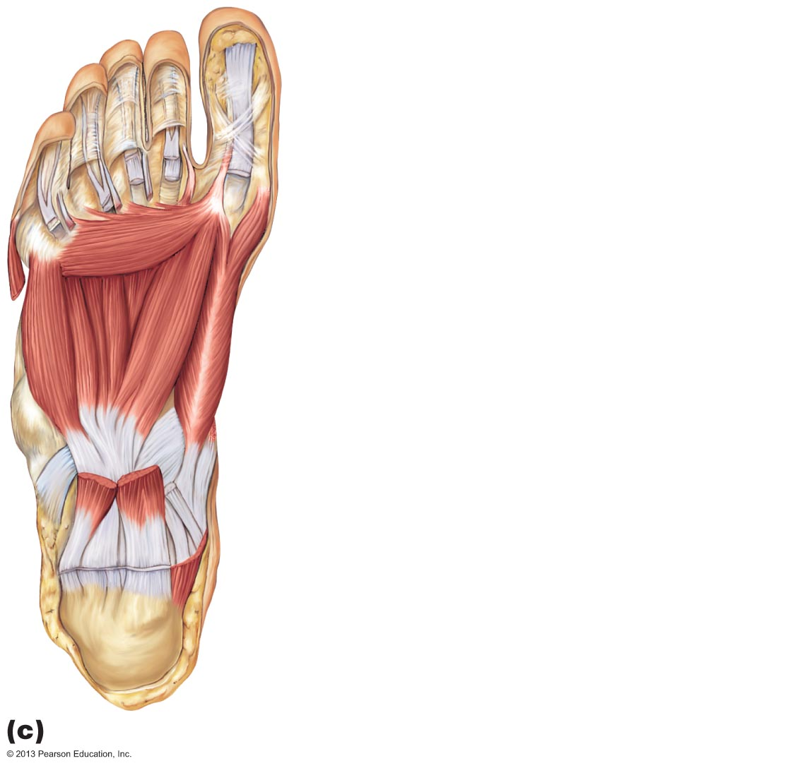
Figure 10.25c Muscles of the right foot, plantar aspect.
Adductor hallucis (transverse head)
Adductor hallucis (oblique head)
Interosseous muscles
Flexor hallucis brevis
Flexor digiti minimi brevis
Fibularis longus (tendon)
Flexor accessorius
Flexor digitorum longus (tendon)
Flexor hallucis longus (tendon)
Third layer (plantar aspect)

Slide 49
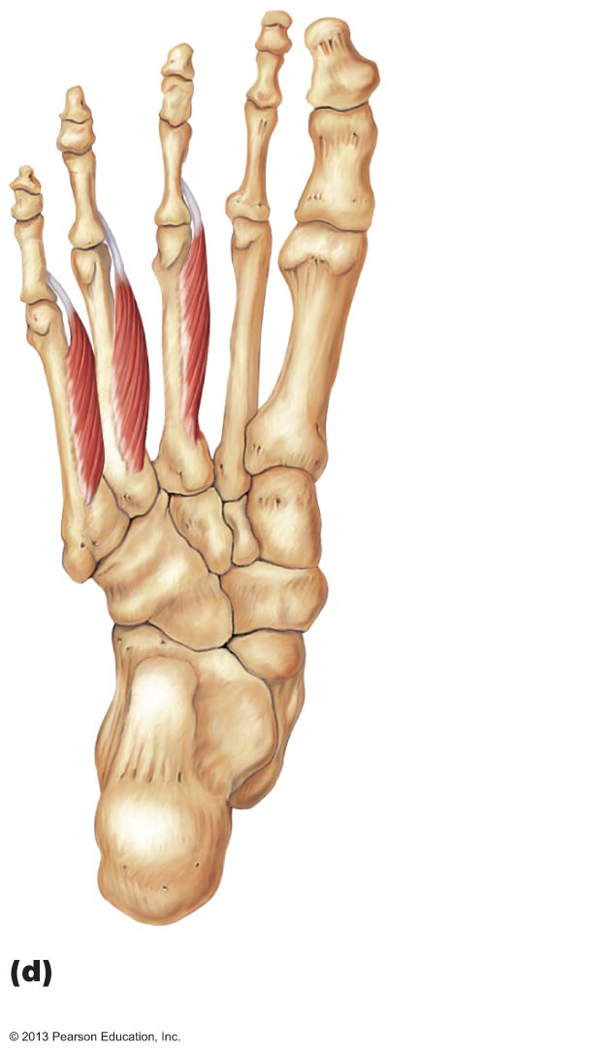
Figure 10.25d Muscles of the right foot, plantar aspect.
Plantar
interossei
PLAY
Animation: Rotating foot
Fourth layer (plantar aspect):
plantar interossei

Slide 50
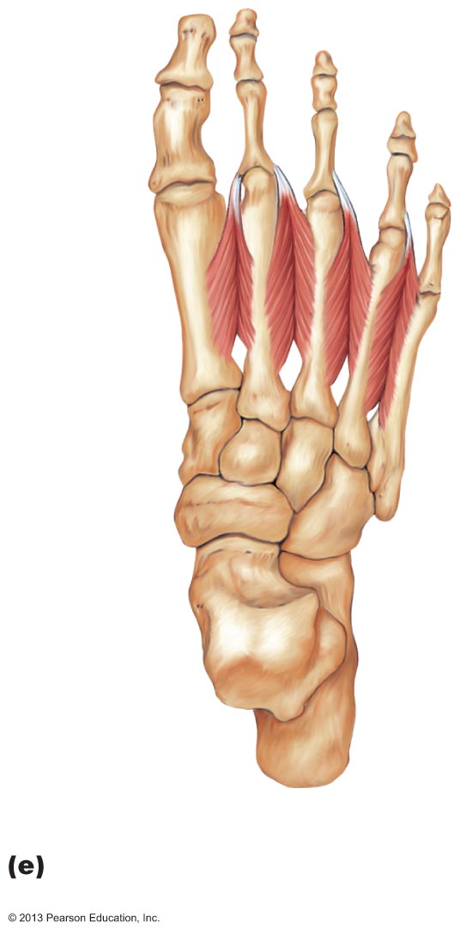
Figure 10.25e Muscles of the right foot, plantar aspect.
Dorsal
interossei
Fourth layer (dorsal aspect):
dorsal interossei

